Slide 1







A Vector Field Design Approach to Animated Transitions
Yong Wang
HKUST
Daniel Archambault
Swansea University
Carlos Scheidegger
University of Arizona
Huamin Qu
HKUST
http://home.cse.ust.hk/~ywangct/proj/vf_animation.html
Notes:
Good morning, everyone, welcome to my presentation. I am Yong WAGN from the Hong Kong University of Science and Technology. The paper I am going to present is “a vector field design approach to animated transitions”. This is a joint work between HKUST, Swansea university and University of Arizona. I would like to thank my excellent collaborators, Daniel from Swansea, Carlos from Arizona and my advisor Prof. Huamin Qu.
We also created a project page for this paper, you can scan the QR code here to access it and check for more details.

Slide 2
Background
Notes:
So before going to the technique details, let me first introduce the overall background and initial motivation of this work.

Slide 3
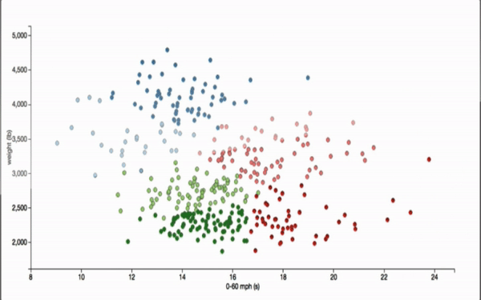
Animated Transitions
They are pervasive in data visualization
They show the general switching between two visualization views
Notes:
Animated transitions are pervasive in data visualization.
They have been widely used to show the switching between two visualization views.
=====
Where the focus is also how to determine the trajectory of each node.

Slide 4
Animated Transition Tasks
When using animated transitions, users often want to
- Track the movement of individual data points
- Track the movement and evolution of point clusters
It is challenging due to the essential dynamic changes of data!
Notes:
For animated transition tasks, in order to know the temporal evolution of the data, users often need to
....
Howerver, this is challenging due to the essential dynamic changes of the data.

Slide 5
Motivation – Psychology Studies
Two key observations from psychology studies:
- Coordinated motion
Points in the same group should move together with similar trajectories^{[1]} (the law of common fate)
- Crowding avoidance
Putting data points too close to each other can result in identity confusion^{[2]}
[1] S. Yantis, “Multielement visual tracking: Attention and perceptual orga- nization,” Cognitive Psychology, vol. 24, no. 3, pp. 295–340, 1992.
[2] S. L. Franconeri, J. Y. Lin, J. T. Enns, Z. W. Pylyshyn, and B. Fisher, “Evidence against a speed limit in multiple-object tracking,” Psycho- nomic Bulletin & Review, vol. 15, no. 4, pp. 802–808, 2008.
.
Notes:
To support better tracking of points and clusters, we motivate our work by surveying psychology studies.
according to our survey, there are two key observations from the psychology studies. That is, coordinated motion and crowding avoidance would benefit tracking in animated transitions.
For coordinated motion, it means ...
for crowding avoidance, ....
=======
Conform with Gestalt law of common fate, Benefit object tracking^{[5]}
Animated transitions should avoid crowding^{[6}

Slide 6
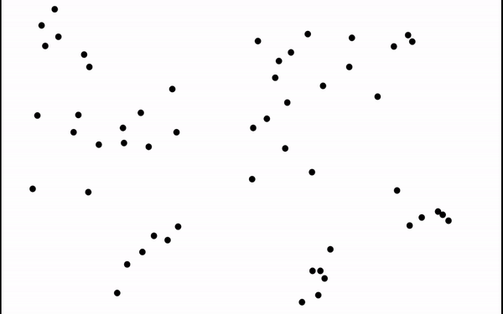
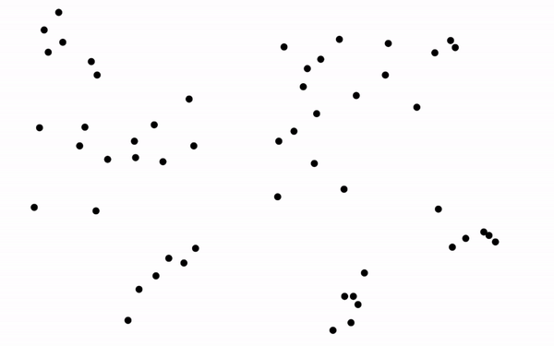
Motivation – Related Work
Two representative methods of animated transition
Linear Transition
Bundled Trajectory^{[3]}
[3] Fan Du, Nan Cao, Jian Zhao and Yu-ru Lin . "Trajectory bundling for animated transitions." CHI, 2015.
Notes:
By now, many research has been done on animated transitions. From the perspective of trajectories, there are two representative methods for animated transitions, that is, linear transition and bundled trajectory.
in linear transition, data points simply follow a straight line
Bundled trajecory budled the trajectory of points within the same group to enhance coordinate motion.
=============
(play left first and then right. Exlain the difference.)

Slide 7


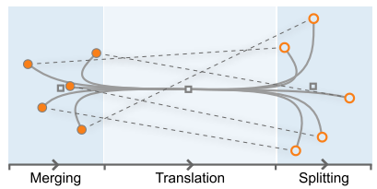
Motivation – Related Work
Two representative methods of animated transition
 | Linear Transition | Bundled Trajectory^{[3]}
Coordinated Motion
Crowding Avoidance
[3] Fan Du, Nan Cao, Jian Zhao and Yu-ru Lin . "Trajectory bundling for animated transitions." CHI, 2015.
Notes:
however, linear transition does not explicitly take coordinated motion and crowding avoidance into consideration. Bundled trajectory can enhance coordinated motion within the same cluster, but it is at the cost of more crowding, because it bundles the trajectories too tightly, as shown in the illustration figure in the bottom right.
=======
Coordinated motion within the group.

Slide 8
Can we enhance coordinated motion and avoid crowding simultaneously in animated transitions?
Notes:
so, a natural question to ask is: Can we enhance ….

Slide 9
Our Approach
Animated transition based on vector field design
- Input: the start and end positions of clustered points
- Output: transition trajectories of points
- Goal: improve object tracking of animated transitions by enhancing coordinated motion within clusters and avoiding crowding
Notes:
So, in this paper, we propose a novel technique for animated transitions based on vector field design.
the input is ...
output is the ...
our goal is to improve…

Slide 10
Our Approach
Animated transition based on vector field design
- General Idea:
Desirable Initial Path
Vector Field
Object Trajectories
Initial Path Generation
Vector Field Computation
Point Advection
Notes:
so the general idea is , we first generate a desirable initial path for each point cluster, then based on this, we construct a vector field for each point cluster, finally, we use the vector field to generate trajectories for the points within the same group, and advect the points from their starting positions to their end positions.
This idea corresponds to the three major building blocks of our method. That is initial path.. ,
We generally follow this procedure step by step to generate animated transition for the points.
----
Just overview.
Slide 2: aniation.

Slide 11
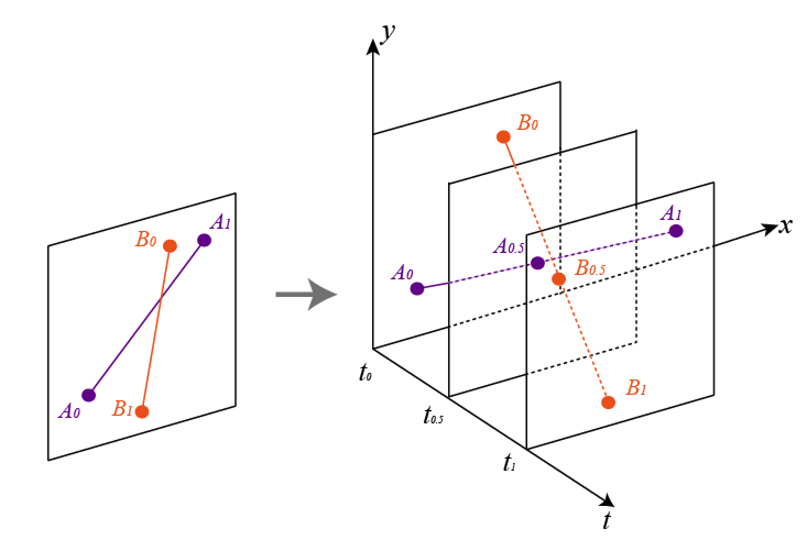
Our Approach – Initial Path Generation
Automated approach:
- a force-directed model in 3D space
Repulsion
Attraction
Smoothening
Notes:
For initial path generation, its purpose is to determine the overall movement of each point cluster.
We first proposed an automated approach for initial path generation.
Inspired from the widely used force-directed model in 2D plane, we propose a force-directed model in 3D space. Basically, we consider three forces, repulsion, attraction and smoothing force.
Repulsion means that for a specific time point, points of different trajectory should push each other away, to avoid crowding in the same time step.
attraction exists between the two consecutive time stamps of the same trajectory, to avoid very long trajectory.
For Smoothening, we basically average the postions of the adjacent timestamps of the same trajectory to avoid zig-zag path.
When the three forces strike a balance, we will get a smooth and desirable initial path, that can enhance coordinated motion and avoid crowding.
---------
Explain the high-level idea

Slide 12
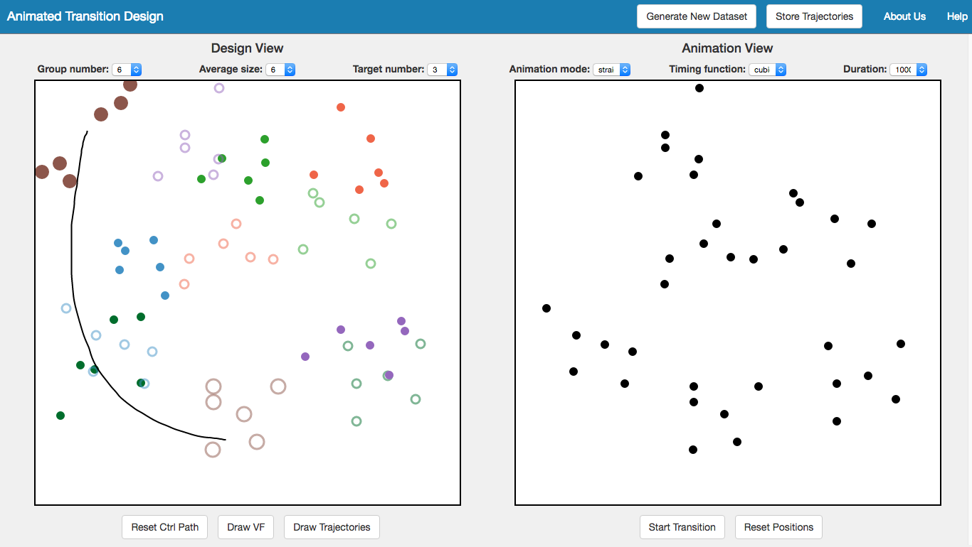
Our Approach – Initial Path Generation
Manual sketching:
- Designers may like flexible design for animation in certain cases
- A user interface is provided
Notes:
Sometimes, designers may also want flexible design of the initial path, so we also support manual sketching.
we implemented a user interface for users to do such kind of sketching.
Users can select a cluster of points by sketching and then draw an initial path to specify the overall movement of the point cluster .
-------
Change the figure, basic explaination.

Slide 13
Our Approach – Vector Field Computation
How to construct a vector field based on an initial path?
- Core idea:
Overlay an n x n grid over the screen to define the vector field
Propose two types of constraints to restrict the vector field
Apply the above two steps to each cluster of points
Notes:
After we gain the initial path for each group of points, then the questions is, how to .... ,
the core idea is , first ,we ...

Slide 14
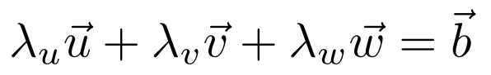
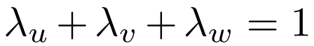
Our Approach – Vector Field Computation
Path constraint
A sample speed vector
Initial path
Grid corners for vector field
Notes:
The first constraint is path constraint.
Let’s have a look at this illustration figure, the red line means the initial path by either automated generation or manual sketching. Vector b is a speed vector on the initial path.
Consider triangle uvw, the speed vector b can be represented as a combination of the speed vectors in the grid corners, u, v, w. so we get this formula:
…..
numbda_u, numbda_v and numbda_w are the barycentric coordinate and their sum is equal to 1.

Slide 15
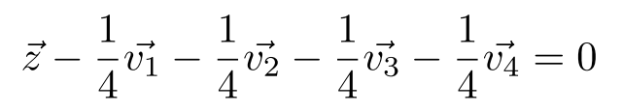
Our Approach – Vector Field Computation
Smoothing constraint
z
Notes:
The second constraint is the smoothing constraint.
To ensure that the vector is smooth, the speed vector in the center corner should be equally made up of the speed vectors of the surrounding 4 grid corners.
So we get this equation.
---------
Each point in the grid

Slide 16
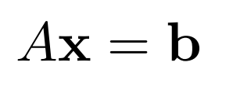
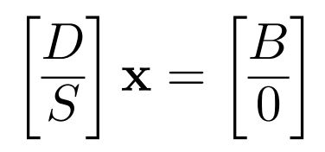
Our Approach – Vector Field Computation
By now, we build an over-constrained linear system:
Path constraint
(T * n² matrix)
Smooth constraint
(n² * n² matrix)
Grid corners defining VF
(n² * 2 matrix)
Conjugate gradient method is used to solve this linear system
Notes:
by now, we ...,
Ax = b
Matrix A can be further divided into two matrices, D and S, where D corresponds to the path constraint and S corresponds to the smoothing constraint. Suppose we sampled T timestamps along the initial path. Then D is a T*n^2 matrix and S is a n^2 by n^2 matrices. and x is the grid corners defining the vector field, which is a n^2 by 2 matrix.
There are no explicit solutions for over-constrained linear system. So we try to find solutions that minimize the errors.
Basically, in this paper, conjugate gradient method is used to solve this linear system.

Slide 17
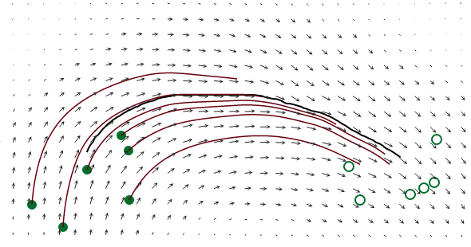
Our Approach – Point Advection
Given the vector field, we treat the points of each cluster as particles in a flow and advect them
The standard 4th-order Runge-Kutta method
Notes:
The third building blocks of our method is point advection.
given, ..., as shown in the figure.
we use the standard 4th .... to generate the trajectories for each point within a cluster.

Slide 18
Our Approach – Point Advection
Given the vector field, we treat the points of the group as particles in a low and advect them
It DOES NOT guarantee each point will definitely reach their end positions!
Notes:
however, one problem here is: such a method does not guarantee each point will definitely reach their end positions.

Slide 19
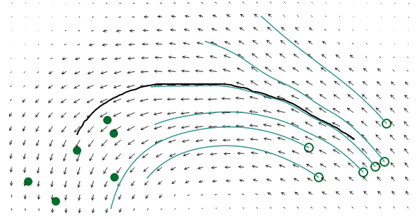
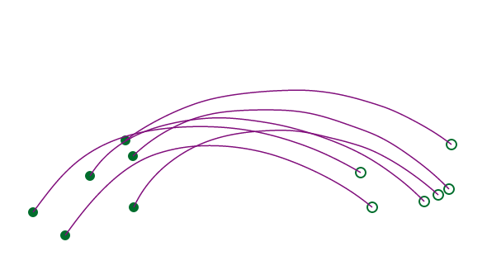
Our Approach – Point Advection
Interpolation of forward and reverse advection
Forward Advection
Reverse Advection
Final
Trajectories
Notes:
so our solution is that we do interpolation of ....
first , we generate the trajectories of the points from the starting poistion to end positon, then, we reverse the vector field, and compute the trajectries from the end position to start positon.
Then, we do linear interpolation to get the final trajectory.
this method is very beautiful as it can generate smooth trajecotries,
effectively reduce the error in the runge kuta methods, and guarantee the reaching of ending positions.

Slide 20
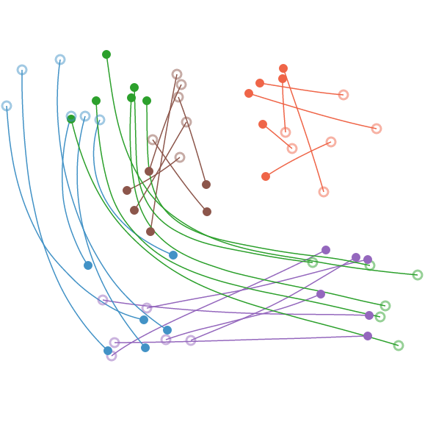
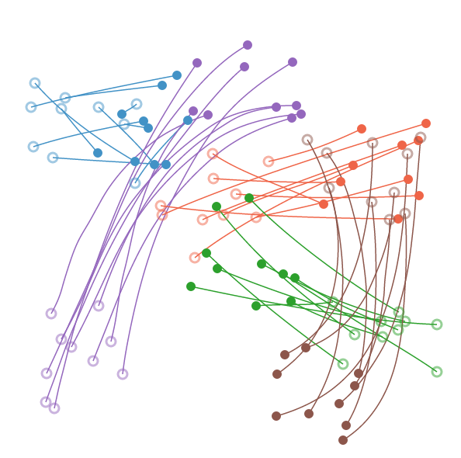
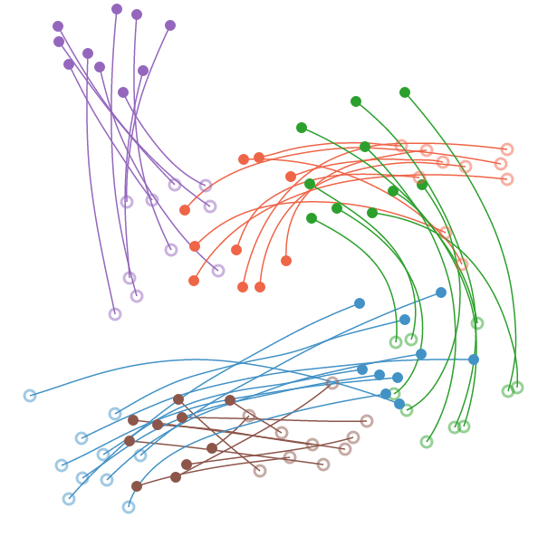
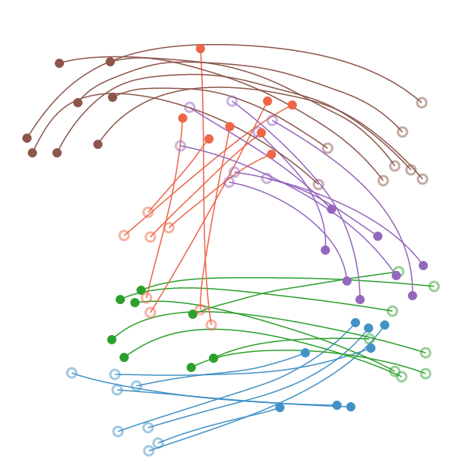
Trajectory Examples
Notes:
Here are some trajectory examples, the trajectories for the same cluster are encoded using the same color.
As we can see, the trajectories are basically smooth and the trajectories of the points from the same cluster will follow the similar directions, enhancing the coordinated motion and avoid occlusion.

Slide 21
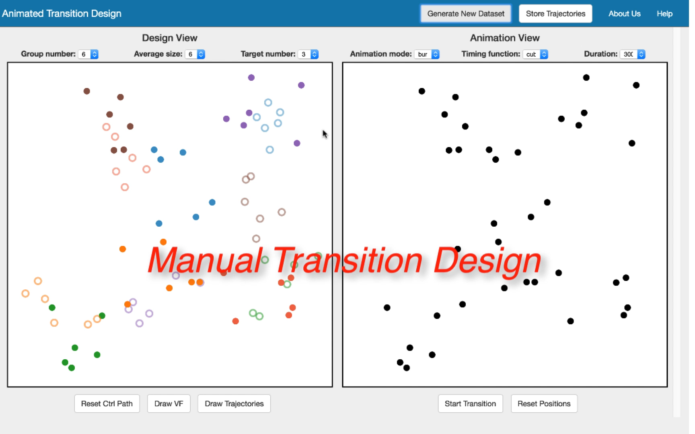
Demo
Notes:
Here, we show a demo to demonstrate how our technique works. So in manual transition design, the initial path of point clusters are gained by manual sketching. Users can select a point cluster and then draw a line to indicate the overall movement trajectory from their start positions towards their end positions.
A vector field is generated for each point cluster.
Finally, we further gain the smooth trajectories.
Here is the result of animated transitions.
The initial path can also be automated generated by our method.
So we can directly gain the final animated transitions.
=======
Need to be improved.

Slide 22
Evaluation
Notes:
In this paper, we conducted both quantitative metric evaluation and an in-depth user study to demonstrate the effectiveness of our system.
Before doing that, we also conduct an informal qualitative user interview.

Slide 23
Evaluation – Qualitative User Interview
Purpose: evaluate the usability of manual transition design
Ask 4 participants to do manual sketching for animated transition design and collect their feedback
Major feedback
- Participants enjoy the flexibility of designing transitions by themselves
- More point clusters bring more difficulty for manual sketching
[3] Fan Du, Nan Cao, Jian Zhao and Yu-ru Lin . "Trajectory bundling for animated transitions." CHI, 2015.
Notes:
For the informal qualitative user interview, its purpose is to evaluate the usability of manual transition design of the initial path.
we asked ..
The results show that ..
More groups means

Slide 24
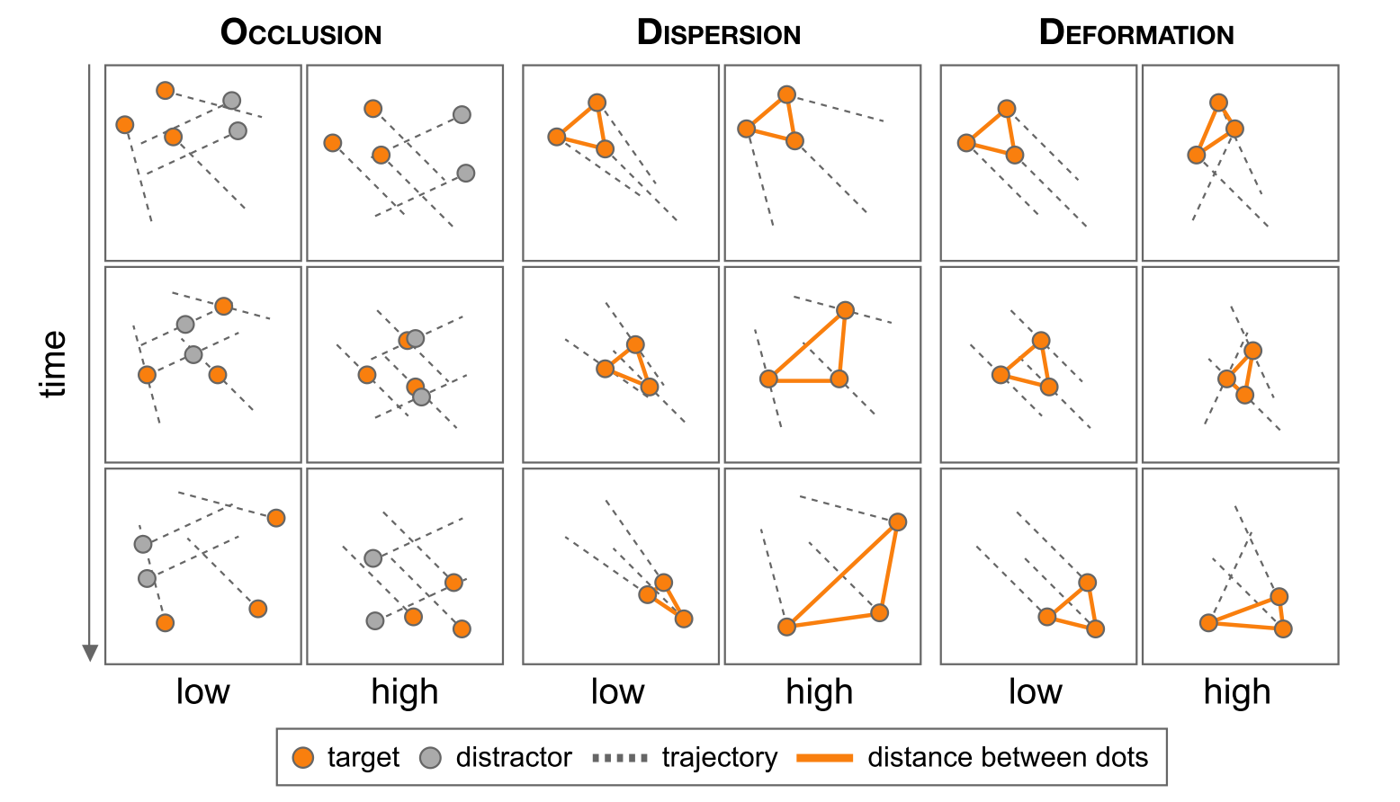
Evaluation – Metric Evaluation
Metrics
- Occlusion
- Dispersion
- Deformation
Datasets
- 50 synthetic transitions
- 20 real transitions
Illustration figure from Reference [3]
[3] Fan Du, Nan Cao, Jian Zhao and Yu-ru Lin . "Trajectory bundling for animated transitions." CHI, 2015.
Notes:
For the quantitative metric evaluation, we follow the prior work to evaluate the animation method by using three types of metrics:
occlusion defines overlapping between points during the animated transitions.
dispersion defines the compactness of the target points during animation. The more compact, the relatively better coordinated motion.
deformation mainly quantifies the stability of the shapes consisting of the target points. The more stable, the better object tracking.
We mainly use two datasets,

Slide 25
Evaluation – Metric Evaluation
Results
- Our approach strikes a good balance in reducing crowding and deformation in animated transitions
Compared with linear transition: lower outer occlusion
Compared with trajectory bundling: lower deformation
For more details, pls refer to our paper
Notes:
Due to the limited time. Here, I only briefly report our result.
........
For more details, pls refer to our paper.

Slide 26
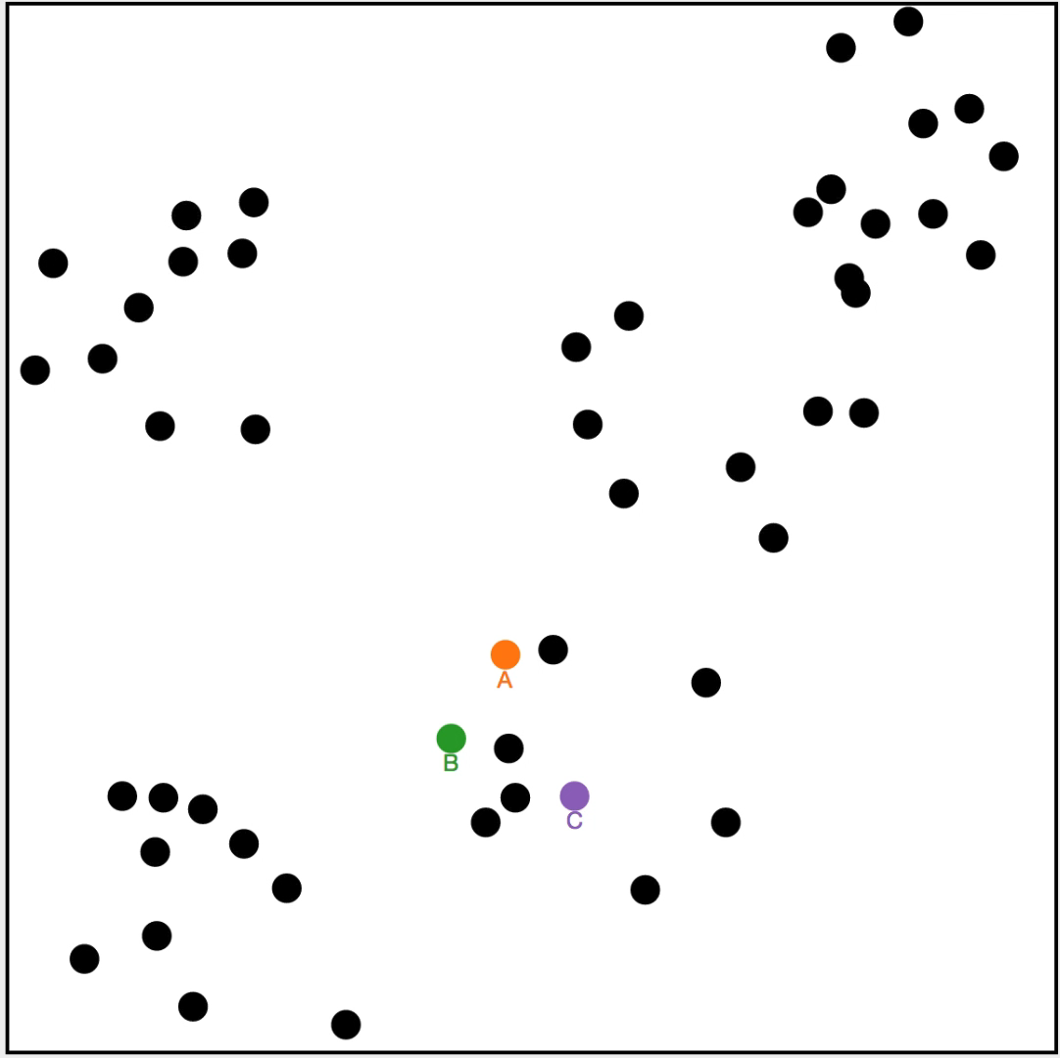
Evaluation – Formal User Study
Tasks: ask 24 participants to track 2 or 3 targets in transitions of high outer occlusion
Notes:
We also conducted a user study to further evaluate the proposed method.
We asked 24 participants to track 2 or 3 targets in ... where they are required to report the identity of each target points. Initially, the identities of target points are shown and highlighted, but during the transitions, the color and identities will be removed.

Slide 27
Evaluation – Formal User Study
Tasks: ask 24 participants to track 2 or 3 targets in transitions of high outer occlusion
Experiment setting:
- 3 techniques (ours, linear transition, trajectory bundling.)
- 2 target number (high: 3, low: 2)
- 2 group size (10 pts/group, 5 groups; 5 pts/group, 10 groups)
Notes:
For the experiment setting,
Basically, we compared three transition techniques, i.e., ours, linear transition and trajectory bundling.
For the target number, we only tested 3 target points and 2 target points. The reason for that is that according to our survey and initial pilot study, we find that when there are two many points for tracking and the identity is also required, it would be quite difficult and the result may be always bad.
And we compared two group size. 10 points per group, 5 groups and ….

Slide 28
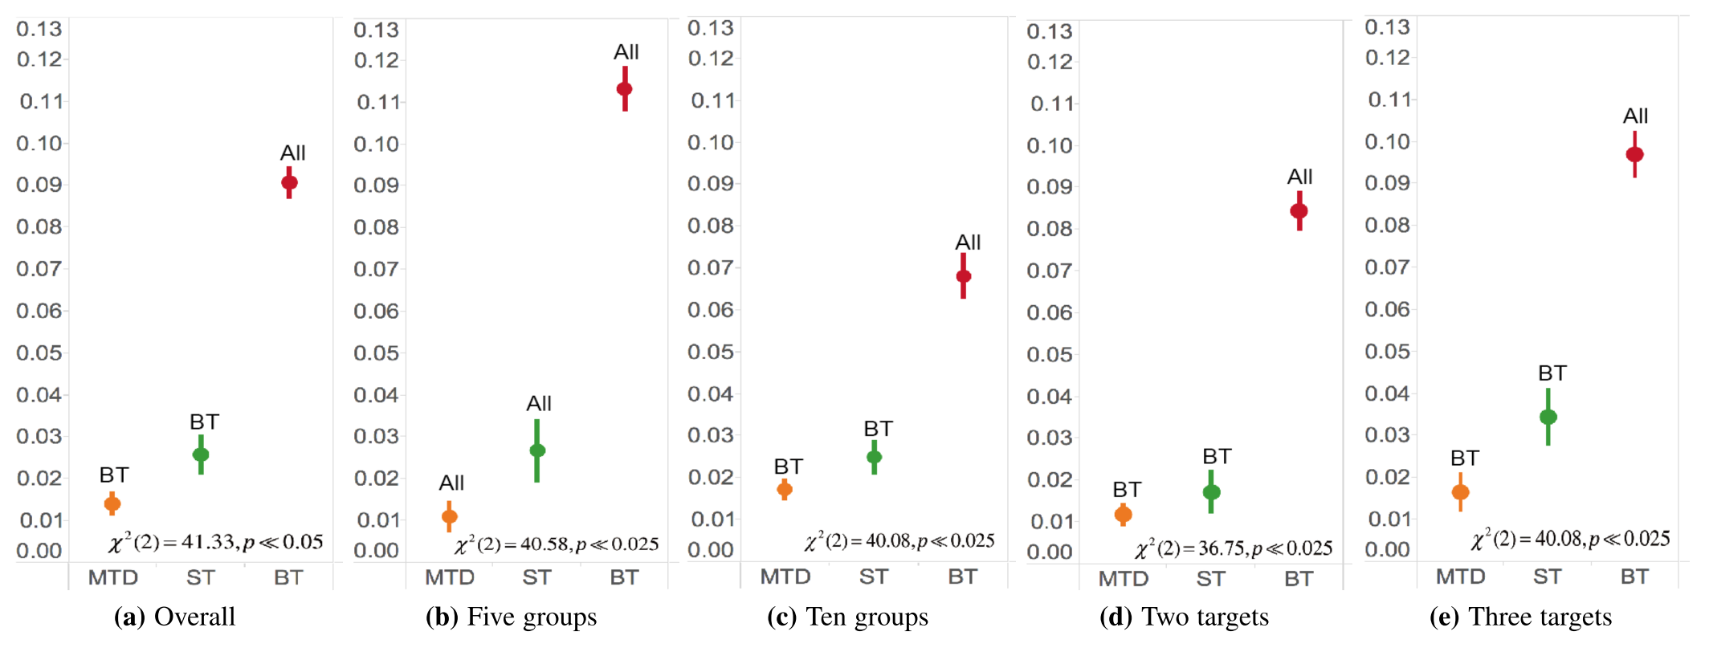
Evaluation – Formal User Study
Results - accuracy
- Our approach has better accuracy (or less error)
Distance between the entered and correct points
Notes:
We evaluated the tracking accuracy in terms of the distance between the correct points and the point entered by the participants.
Our approach significantly outperforms bundled trajectory in terms of tracking accuracy, and has consistent lower error rate than st, and significantly so in the 5 groups.
======back up =====
In the evaluation, we also evaluate the response time, that is , we record the time from the finishing time of a animated transition to the time that a participant enter their result.
Our result shows that our method has a similar response time with straight line trajecgtory and much smaller response time than bundled trajectory.

Slide 29
Summary and Discussion
The proposed animated transition approach using vector field design:
- Strike a good balance in lowering occlusion and deformation
- Enhance coordinated motion and avoid crowding
- Improve tracking accuracy in transitions of high occlusion
Limitations
- Scalability issues
- Very curved trajectory may influence tracking accuracy
Notes:
To recap what we have done in this paper. Basically, we proposed an animated transition approach based on vector field design. It strikes a good balance in lowering occlusion and deformation, enhance coordinated motion and avoid crowding in animated transitions.
Accordingly, the tracking accuracy in transitions of high occlusion will also be improved.
But there are also some limitaitons of our approach.
the improvement of of tracking accuracy is not without upper bound. when there are too many points with very serious visual clutter, the proposed method may also not improve too much.
In addition, sometimes, very curved trajectory may also influence tracking accuracy.
====
- Edges are not considered in the animation

Slide 30
A Vector Field Design Approach to Animated Transitions
Yong Wang
HKUST
Daniel Archambault
Swansea University
Carlos Scheidegger
University of Arizona
Huamin Qu
HKUST
http://home.cse.ust.hk/~ywangct/proj/vf_animation.html
Notes:
That’s all of my presentation. And I am glad to take any questions from you guys.

